Slide 1
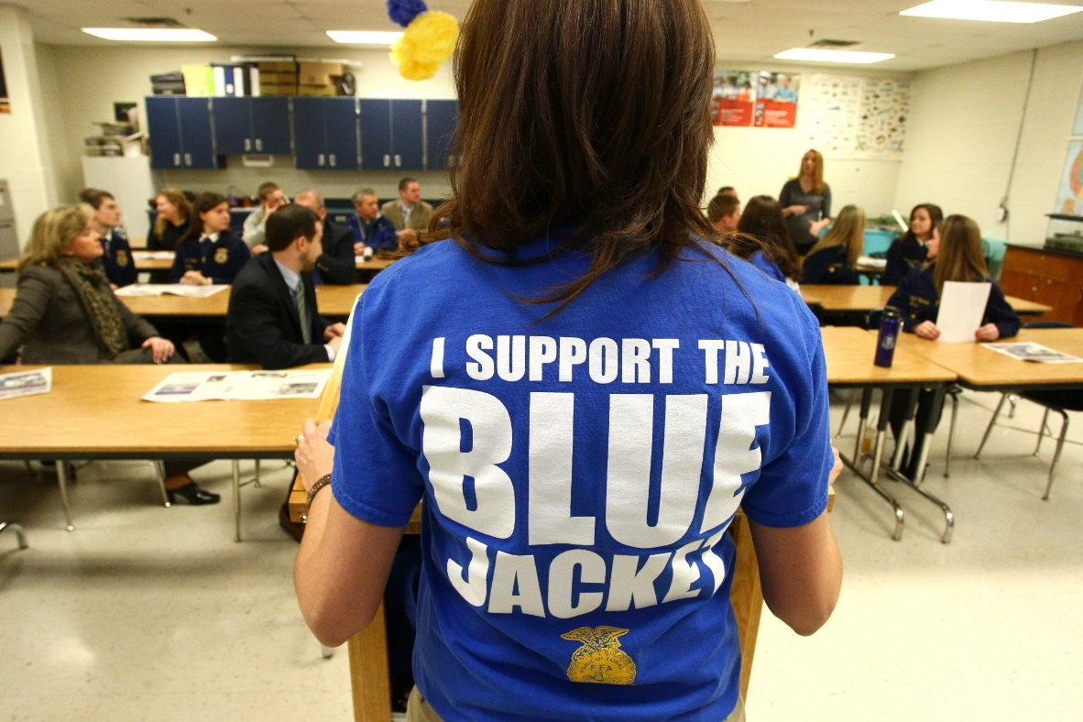
National FFA Alumni Association

Slide 2
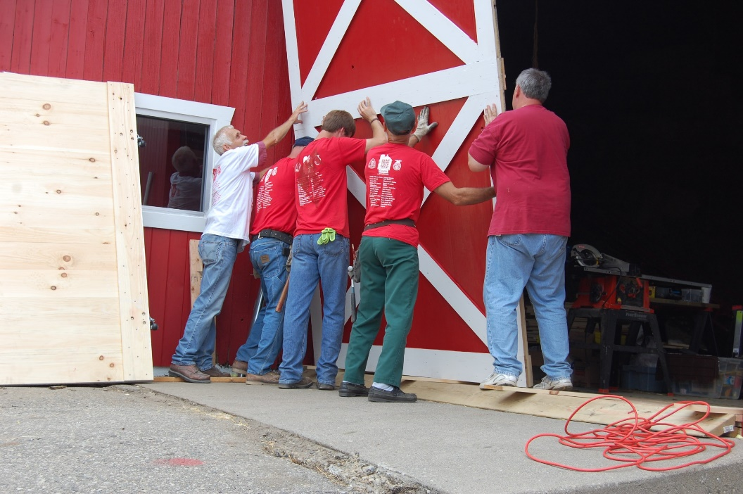
Objectives
To explain what the National FFA Alumni Association is including benefits and opportunities
To empower FFA Alumni to help grow leaders, build communities, and strengthen agriculture
Notes:
Alumni has the same mission and vision of FFA: We are FFA

Slide 3
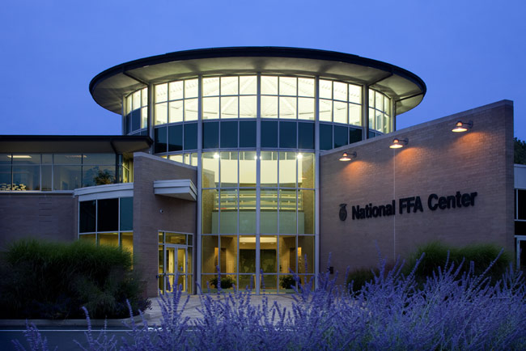
WHO ARE WE?
National FFA Alumni Staff
Joshua Rusk
Alumni Executive Director
Allie Ellis
Alumni Education Specialist
Jada Buchanan
Communications and Marketing Manager
Notes:
Contact alumni@ffa.org with any questions. We also have a national alumni council with regional vice-presidents. You can request council or staff for workshops, visits, etc. using request forms on www.ffa.org/alumni.

Slide 4
Types of Membership
Annual (1-year membership that is renewed annually)
Affiliation Program (chapters that pay a flat fee and are able to submit an unlimited number of annual members)
Life (One-time investment for lifelong membership)
Non-Traditional Alumni Chapters are available to groups, businesses and corporations that want to connect their members to chapters
Notes:
Update online profiles to ensure your graduates are given the alumni role; with affiliated chapters, you can have as many members on your roster as you want who will then have access to information and opportunities

Slide 5
Benefits for Alumni
Continuing the FFA journey
A chance to give back your skills at the local level
Community service
Access to relevant information and resources: www.ffa.org/alumni
Opportunity for grants, scholarships, and awards to help you, your Alumni chapter, and your local FFA chapter
Magazine subscriptions
Leadership opportunities
Advocacy
Networking and career connections

Slide 6
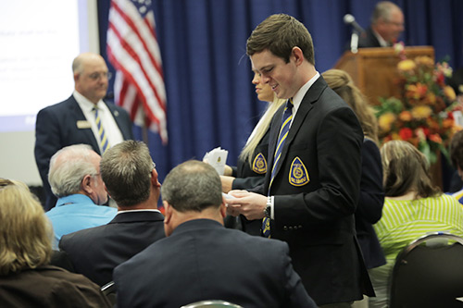
Events
Locally organized events
State events
Regional Development Conferences
Free and for anyone: teachers, alumni, potential alumni
www.ffa.org/GotoRDC
FFA Alumni Day at National FFA Convention
Plus additional convention volunteer opportunities

Slide 7
Growing Quality
Developing Premier Leadership and Stewardship with Business Operations
FFA Alumni Member Development through Benefit, Professional and Personal Development and Member Recruitment
Advocacy for Agricultural Education through Community and School Officials Support and Community Service
Agricultural Education and FFA Program Development through Student Recruitment, Cooperation, Teacher Support and Financially
Student Development through Premier Leadership, Personal Growth and Career Success
Notes:
Alumni members give teachers time to teach! (Everyone go around the room and say one thing they could help with as Alumni: CDE coaches, filling out applications, chaperoning, childcare, food, recruitment, fundraising, scholarships, etc.)

Slide 8
#FFAalumni
alumni@ffa.org
www.ffa.org/alumni
Notes:
Follow FFA Alumni on social media and create your own social media accounts to help tell the story!

